Slide 1


Springleaf Kaggle Competition
A search for improving on the Benchmark Score
Wendell Kuling, SlideRule DS Intensive student
(mentored by Alex Chao)
Amsterdam, November 2015

Slide 2
I would be top-50 (Post-Deadline) in the Kaggle Competition but didn’t find a large jump in performance to the benchmark Management Summary
As a Capstone project for my DS Intensive Course, I participated in the SpringLeaf Kaggle competition.
I would have a top-50 performance, but finished only post-deadline
Although I found some improvements (0.79734⁽¹⁾), I didn’t find a ‘breakthrough’ to the benchmark (0.79706⁽¹⁾)
However, attempts that didn’t improve performance, made my Capstone project a great learning experience
Key lessons learned:
Make sure you have XGBoost in your arsenal, understand it deeply to know steps you DON’T have to try
Alex Chao, my mentor, taught me it’s about being able to solve problems on my own, not knowing the solution
(1) The metric used for the score is the AUC for the Private Leaderboard (e.g., using all instances in the test-set)

Slide 3
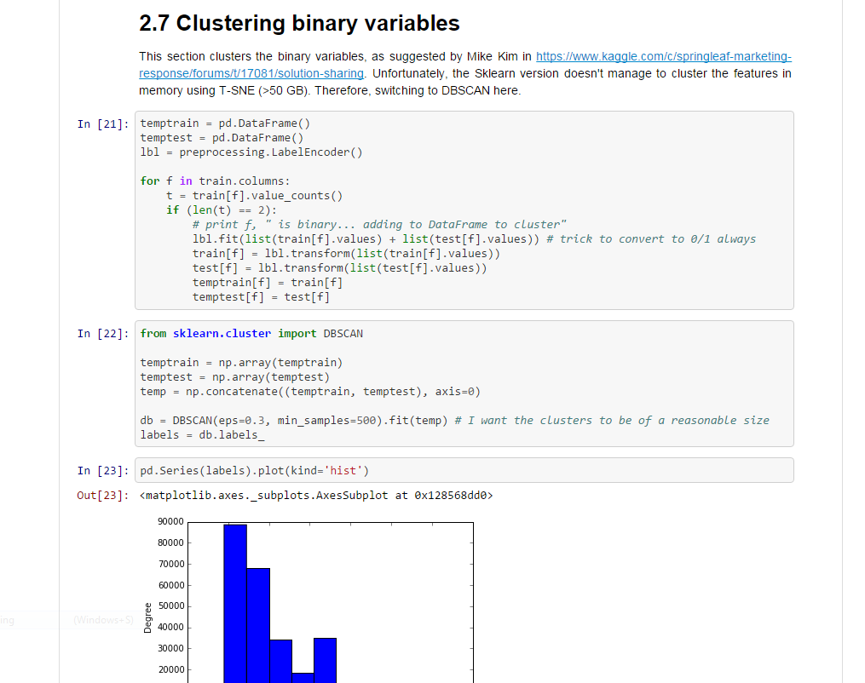
The steps I took, are documented in an iPython Notebook
Link to notebook:
https://github.com/wkuling/Kaggle_springleaf/blob/master/Process/Kaggle%20Springleaf%20with%20XGBoost.ipynb
Note for the notebook to run properly, Anaconda install + installation of XGBoost is required.
Note for the algorithms to work properly, a machine with 16GB of RAM is advised

Slide 4
Contents of this presentation
What is the SpringLeaf Marketing Competition about?
Setting the benchmark
Approaches to beating the benchmark
Lessons Learned and next steps

Slide 5
Springleaf Kaggle competition: determine whether to send a direct mail piece to a customer
Springleaf offers their customers personal and auto loans.
Direct mail is important for Springleaf's to connect with customers whom may be in need of a loan.
Using a large set of anonymized features (~140K rows, ~2000 variables), Springleaf is asking you to predict which customers will respond to a direct mail offer.
You are challenged to construct new meta-variables and employ feature-selection methods to approach this dauntingly wide dataset.

Slide 6
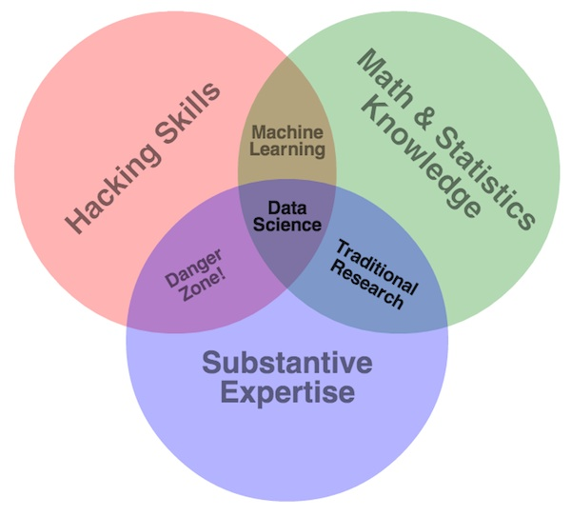
Why the Springleaf marketing competition?
1 GB files (140K+ rows)
Feature engineering key
>2000 variables: feature selection
Relevance for ING Bank:
optimizing response rate of customers

Slide 7
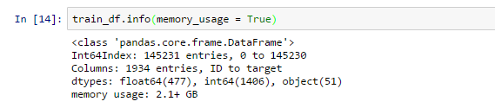

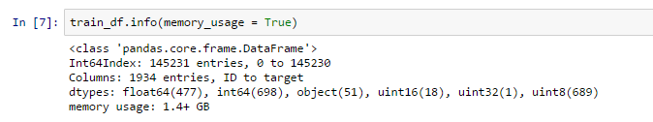
Some further exploration of the SpringLeaf training dataset
Without specification of dtypes
With specification of dtypes (e.g., https://www.kaggle.com/ericcouto/springleaf-marketing-response/reading-train-and-test-using-less-memory)
Specifying the dtypes explicitly helps to memory-efficiency,
but not algorithm performance (number of type ‘object’ stays the same)

Slide 8
Contents of this meeting
What is the SpringLeaf Marketing Competition about?
Setting the benchmark
Approaches to beating the benchmark
Lessons Learned and next steps

Slide 9
Two key benchmark codes available: XGBoost as benchmark
Private leaderboard scores
(AUC)
LR hashing
XGBoost
Logistic Regression with Hashing Trick
Hashing all key/value pairs
Online learner (SGD)
Logistic Regression
Source: https://www.kaggle.com/kartikmehtaiitd/springleaf-marketing-response/stochastic-gradient-descent
XGBoost using basic preprocessing
Only dropping ‘sparse’ columns
Label encoding remainding columns
Gradient Boosted Decision Trees
Source: https://www.kaggle.com/c/springleaf-marketing-response/forums/t/17089/beating-the-benchmark

Slide 10
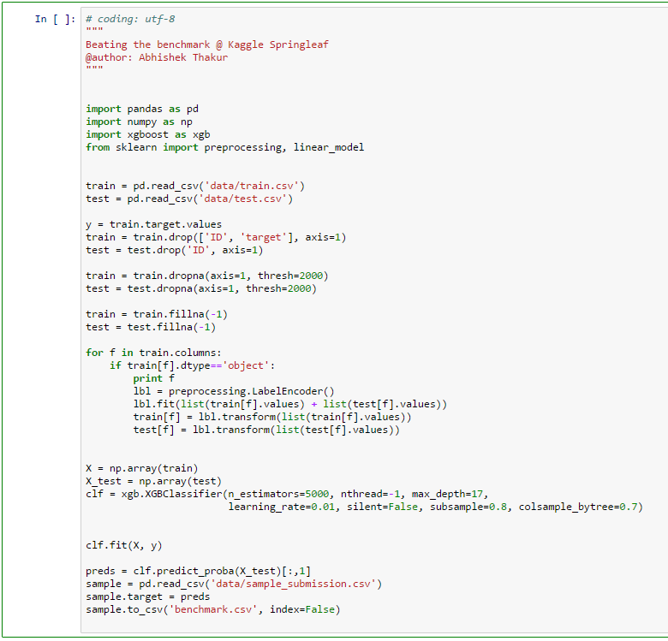
What does the XGBoost Benchmark Solution do?
XGBoost using basic preprocessing
Drop ‘sparse’ columns with <2% non-N/As
Filling remaining ‘N/As’ with -1
Label encode 51 ‘object’ columns
Train Gradient Boosted Decision Trees
(with tuned parameters)
Source: https://www.kaggle.com/c/springleaf-marketing-response/forums/t/17089/beating-the-benchmark
1
2
3
1
2
4
3
4

Slide 11
Contents of this meeting
What is the SpringLeaf Marketing Competition about?
Setting the benchmark
Approaches to beating the benchmark
Lessons Learned and next steps

Slide 12
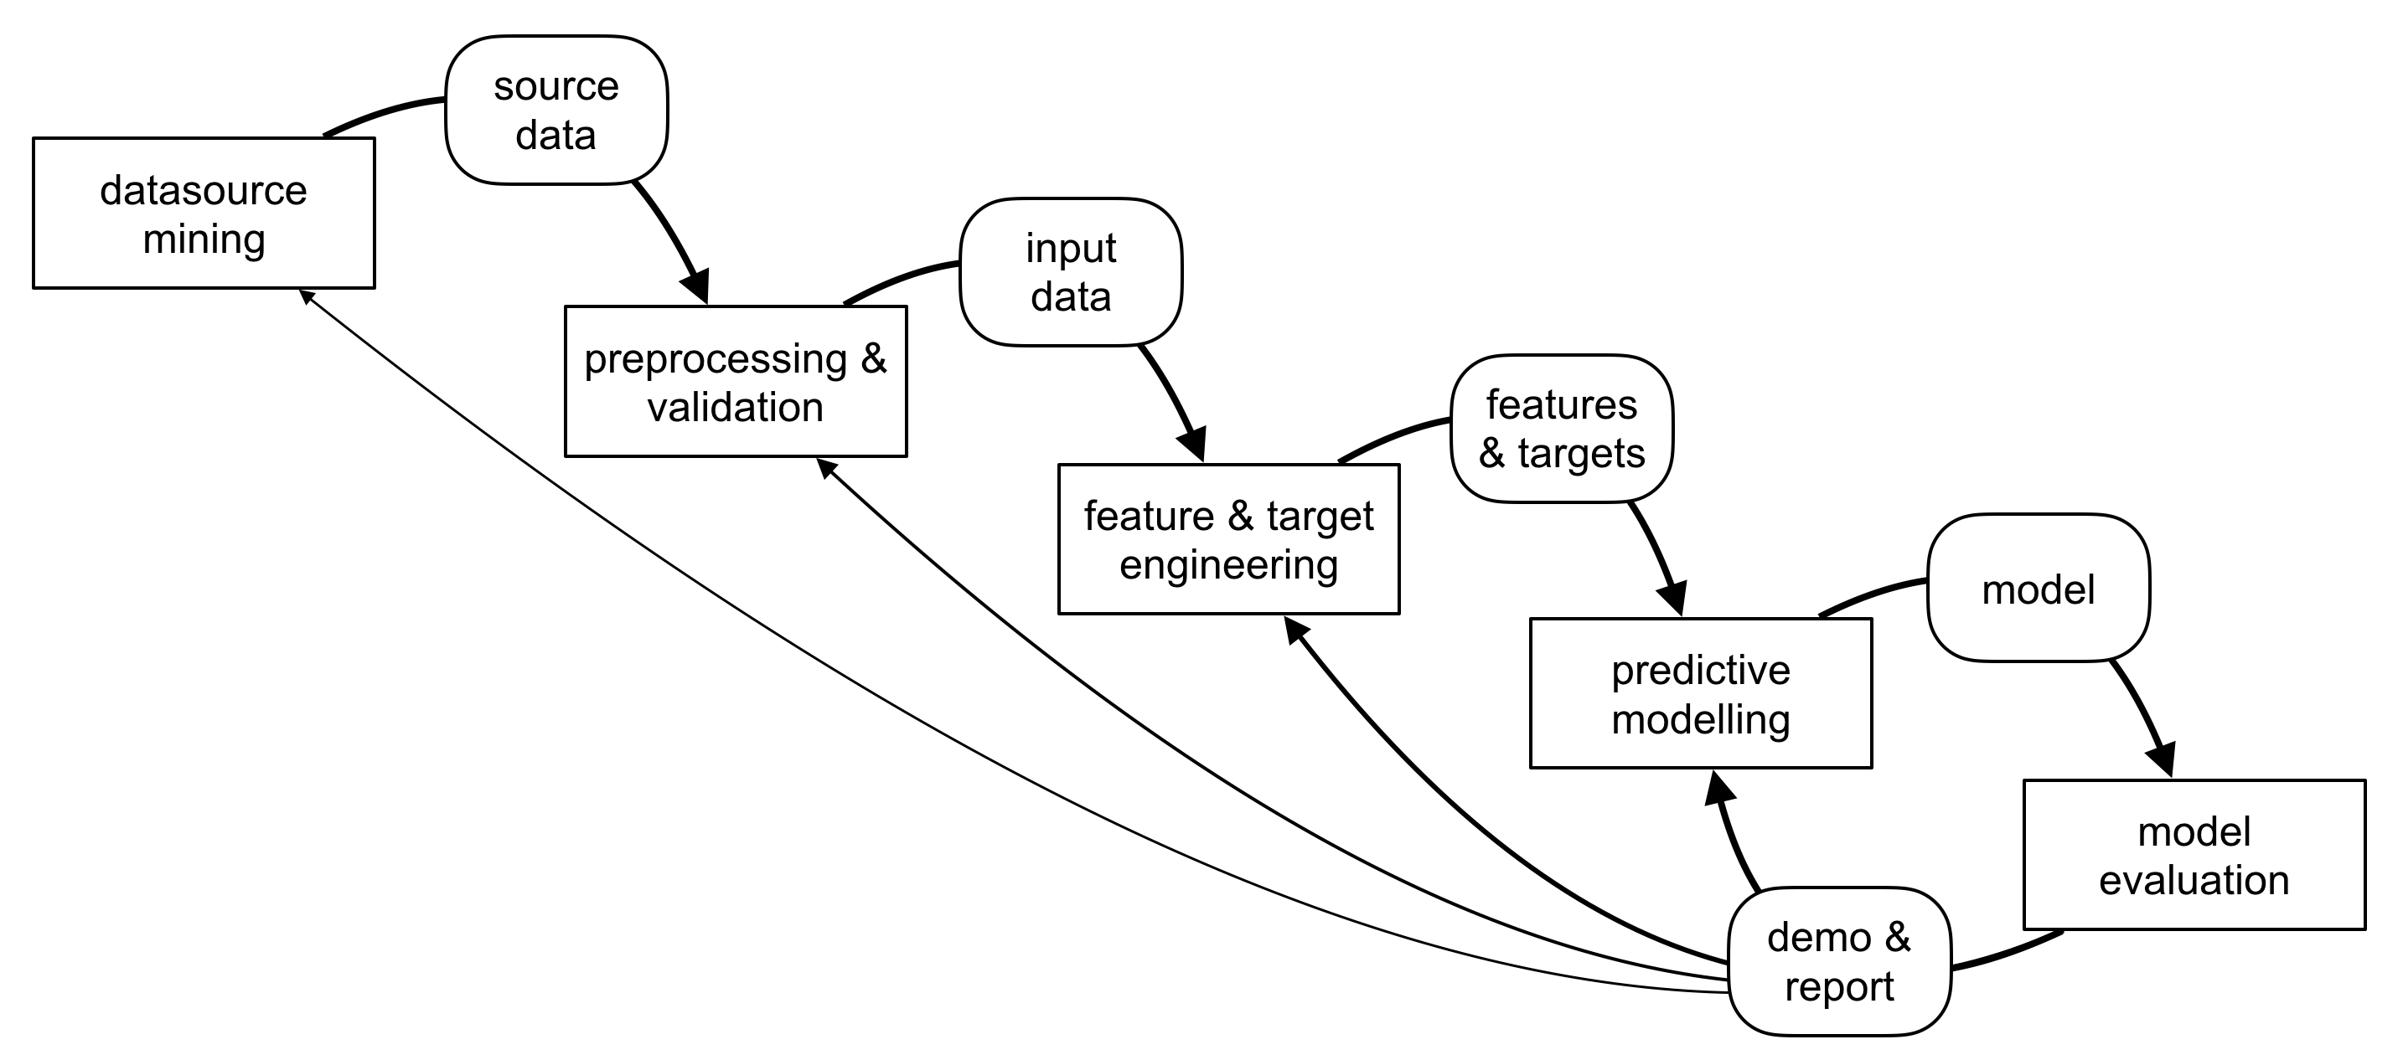
I tried to improve benchmark in several DS process steps
Overview of DS process steps
1
Improve on
pre-processing:
Handle missing data better
2
3
4
Improve
Parameter tuning and
ensemble method
Improve
feature engineering:
Develop better features
Tried
Other models than
XGBoost

Slide 13
Steps attempting to improve the preprocessing of data
1
Benchmark
Dropping columns with less than 2000 non-N/As in them
Filling the N/As with -1
Improvement attempts
Using pd_get_dummies for all low-cardinality columns
Time variables: converted to ‘days ago’
Location variables: dropped similar columns and ‘ID-like’ variables
Age variables: dropped similar columns and columns
Helped?

Slide 14
Steps attempting to improve feature engineering
2
Benchmark
Using label-encoding for all ‘object’ type variables
Improvement attempts
Per row, added the number of:
N/A’s
Numbers containing ’99’
Number of ‘-1’
Added distances for all time vars
Added per zip-code category mean and stdev of target
Added per age category mean and stdev target
Clustered (DBSCAN) binary variables
Helped?

Slide 15
Steps attempting to improve upon the model, failed
3
Benchmark
XGBoost
Improvement attempts
Using RF from Sklearn
Using ExtraTreesClassifier from Sklearn
Using LR from Sklearn
SGDclassifier
Helped?
Sklearn was not performing well with larger datasets:
Batch methods ran out of memory on total dataset
Even on machine with 24GB of RAM
Even when pickling / deleting all variables in memory (%xdel, pickling in preprocessing)
Performance on sub-sets was very low: <0.65 (vs. 0.79 for benchmark)
Online methods showed large (initial) performance gap with benchmark

Slide 16
Parameter tuning and ensemble methods helped slightly
3
Benchmark
Parameters used:
5000 trees
17 max depth
Column sample of 0.7
Row sample of 0.8
Learning rate (eta) 0.01
Improvement attempts
Parameter tuning
Larger number of trees
Increased max depth of trees
(combined with dummies for categ.)
Reduced column sample
Increased learning rate
Ensemble method of XGBoost, through feature importance split by idx mod 5
LR on seperated models
AdaBoost on seperated models
Helped?

Slide 17
Contents of this meeting
What is the SpringLeaf Marketing Competition about?
Setting the benchmark
Approaches to beating the benchmark
Lessons Learned and next steps

Slide 18
My key lessons learned
Make sure you have XGBoost in your arsenal, understand it deeply to know steps you DON’T have to try
Does label-encoding or one-hot-encoding make a big-difference?
How important is clustering in an XGBoost method? And leaving out highly-correlated columns?
Do you expect an ensemble method based on sub-selections of columns and a LR to work well?
Being fluent in both Python, Pandas and Numpy is key
Using libraries for Regular Expressions, Timedate conversions and others are key as well
I really learnt this by applying it in practice, e.g., on my Capstone project
Sklearn is very valuable, but not for ML on really large datasets
I found Sklearn to be helpful in the area of preprocessing (label-encoding, train/test split etc.)
However, the ML and clustering methods are not always sufficiently memory efficient
A bigger machine (16 GB Macbook Pro, 24 GB Unix-based machine) doesn’t solve this problem for you
Most importantly, my mentor taught me it’s key to solve problems on my own, rather than telling the solution

Slide 19
Next steps: make things scale
Improve on preprocessing:
Measure the quantitative individual effect of pre-processing steps
Tune choices made in preprocessing (e.g., N/A drop, clustering)
Parameter tuning / Grid Search:
Num_rounds, Max depth of trees
Subsample and colsample_by_tree
Min_child_weight (generalization)
Models:
Try Neural Network
FM (Factorization Machines)
Ensemble:
Insert LR / NN into XGBoost
Insert leaf nodes of XGBoost into FM
Logistic Regression on multiple model scores (stacking)
All these next steps require substantial
computing power:
I plan to use Spark for this
(after my elective courses)

Slide 20
My suggestions for the DS Intensive Course from Sliderule
First of all, it’s a great course that I would recommend to everyone serious about learning DS
Mentor based approach really adds a lot to the MOOCs
Materials carefully selected: appears ‘messy’ at first, but makes a lot of sense later
Three things I’d suggest to add to the training:
Cover XGBoost as a state-of-the-art algorithm
Data Science at the Command Line as a ‘Data Scientist’s intro to Unix’
In general, references to ‘standard works’ such as Data Analysis using Python and other O’reilly books (a combi offer with Safari Books would be great)

